Slide 1

Project Title: VideoVigil
Mubashir Ahmed FA20-BSE-063
Nabeel Ahmad FA20-BSE-170
Ghulam Abbass FA20-BSE-053
Supervisor: Mam Neeli Khan
Department of Computer Science
COMSATS University Islamabad, Abbottabad Campus

Slide 2
Agenda of the Presentation
Current surveillance lacks automated violence detection at a large scale.
Manual monitoring is impractical and time-consuming, hindering timely responses.
Proposal aims to develop a real-time violence alert extension for video content.
The system will automatically identify violence and notify users promptly.

Slide 3
Brief Introduction
Develop a web browser extension for automatic violence detection in videos.
Address the lack of large-scale, automated surveillance for harmful content.
Real-time violence alert system to identify and notify users about harmful content.
Utilize deep learning to extract features, classify videos, and deploy as a browser extension.
Enhance online safety, raise awareness of dangers, and promote responsible internet use.

Slide 4
Scope
Train and Improve efficient deep learning model for real-time violence detection.
Create web browser extension for instant content scanning and marking.
Utilize diverse features, including frames, for accurate video classification.
Avoid impractical features hindering real-time detection.
Refrain from biased datasets perpetuating model biases.
Address challenges of computational efficiency in training and deployment.

Slide 5
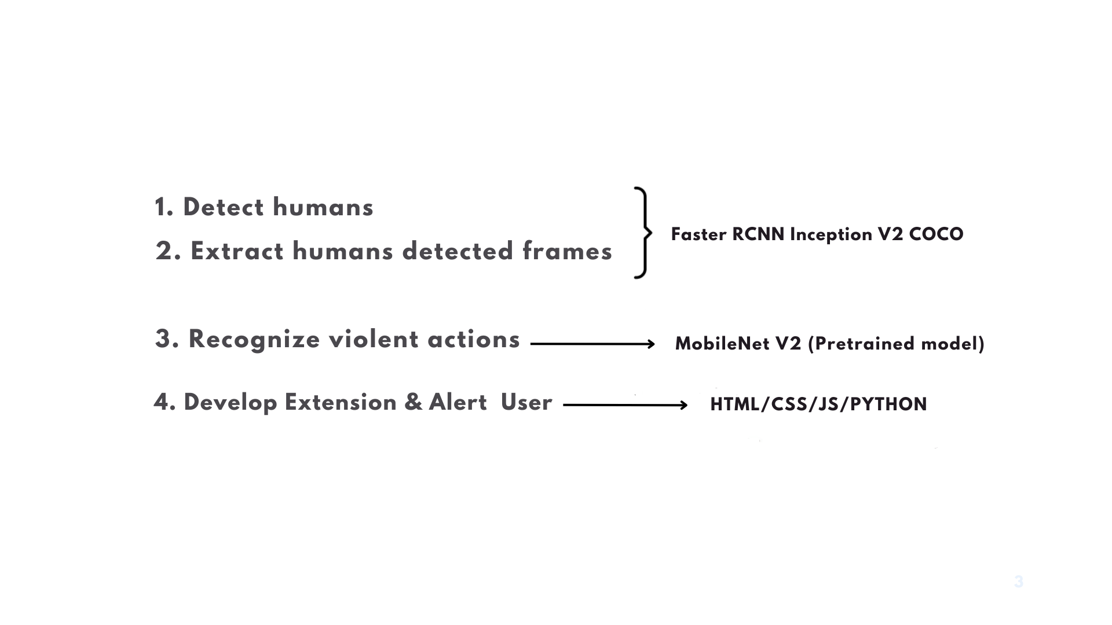
Methodology

Slide 6
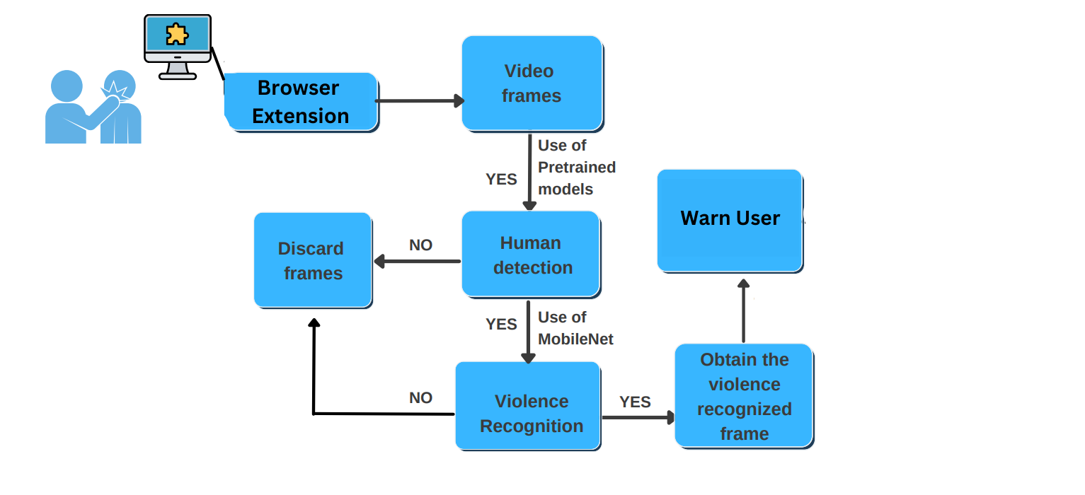
Working

Slide 7
Functional Requirements
Video Analysis and Detection
Warning Message Generation
Real-Time Processing
Responsiveness

Slide 8
Non-Functional Requirements
Usability:
Web Extension will be able to scan all sorts of videos
Performance:
It will be able to scan videos frame by frame to check violence in the videos
It will be able to scan videos within time frame and use it
Scalability:
It can be installed on any sort of browser
It will be easy for any sort of users to install it

Slide 9
User Goals
Enhance user safety by proactively identifying and alerting users to potential violent or harmful content in online videos.
Provide timely warnings to users, allowing them to navigate the internet securely and avoid exposure to harmful content.
Empower users to contribute to online safety by reporting incidents and fostering a responsible online environment.

Slide 10
Use Cases
Extract Frames
Human Detection
Violence Detection
Warn/Alert User

Slide 11
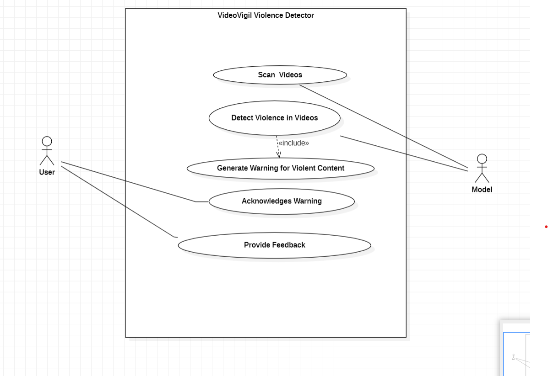
Use Case Diagram

Slide 12
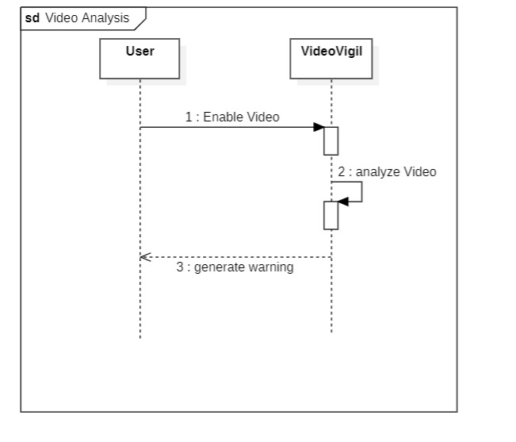
Sequence Diagram

Slide 13
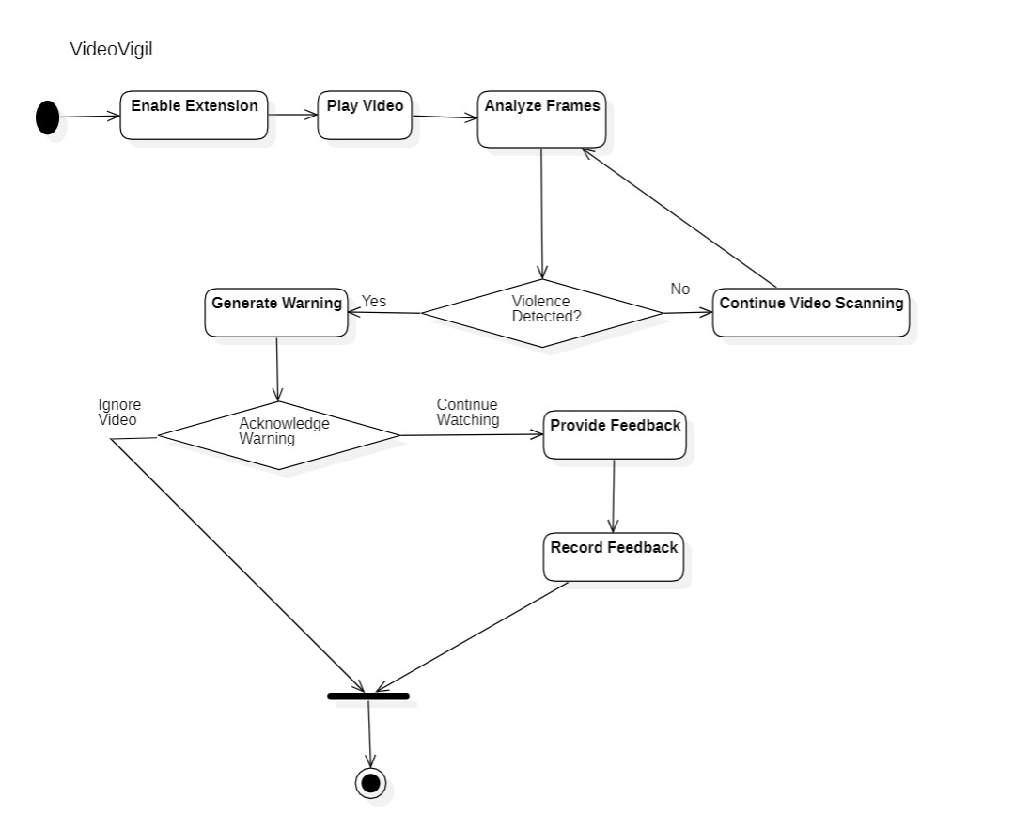
Activity Diagram

Slide 14
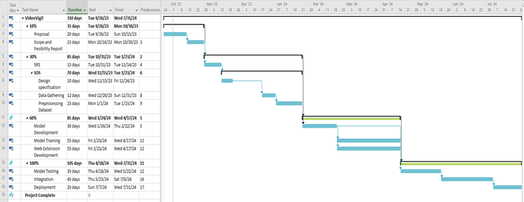
Schedule

Slide 15
Details of 1st Iteration (30%)
We have completed the documentation for our Project which includes
SRS, SDD
In the first Iteration we have compared different models and chosen one with high accuracy.
We have completed stage 1 of human detection successfully with pretrained model

Slide 16
Details of 2nd Iteration (60%)
In the second stage we will be using frames from iteration one and we will be testing violence detection through a large diverse dataset.

Slide 17
Thank You

